Slide 1
Team ΔΣβ (DSB) presents
Sacramento County Restaurant Food Safety
To reduce food-borne illness, hospitalizations and associated deaths

Slide 2
CDC Annual Estimates for USA
76,000,000 people get sick
300,000 hospitalizations
5,000 DEATHS

Slide 3


Slide 4
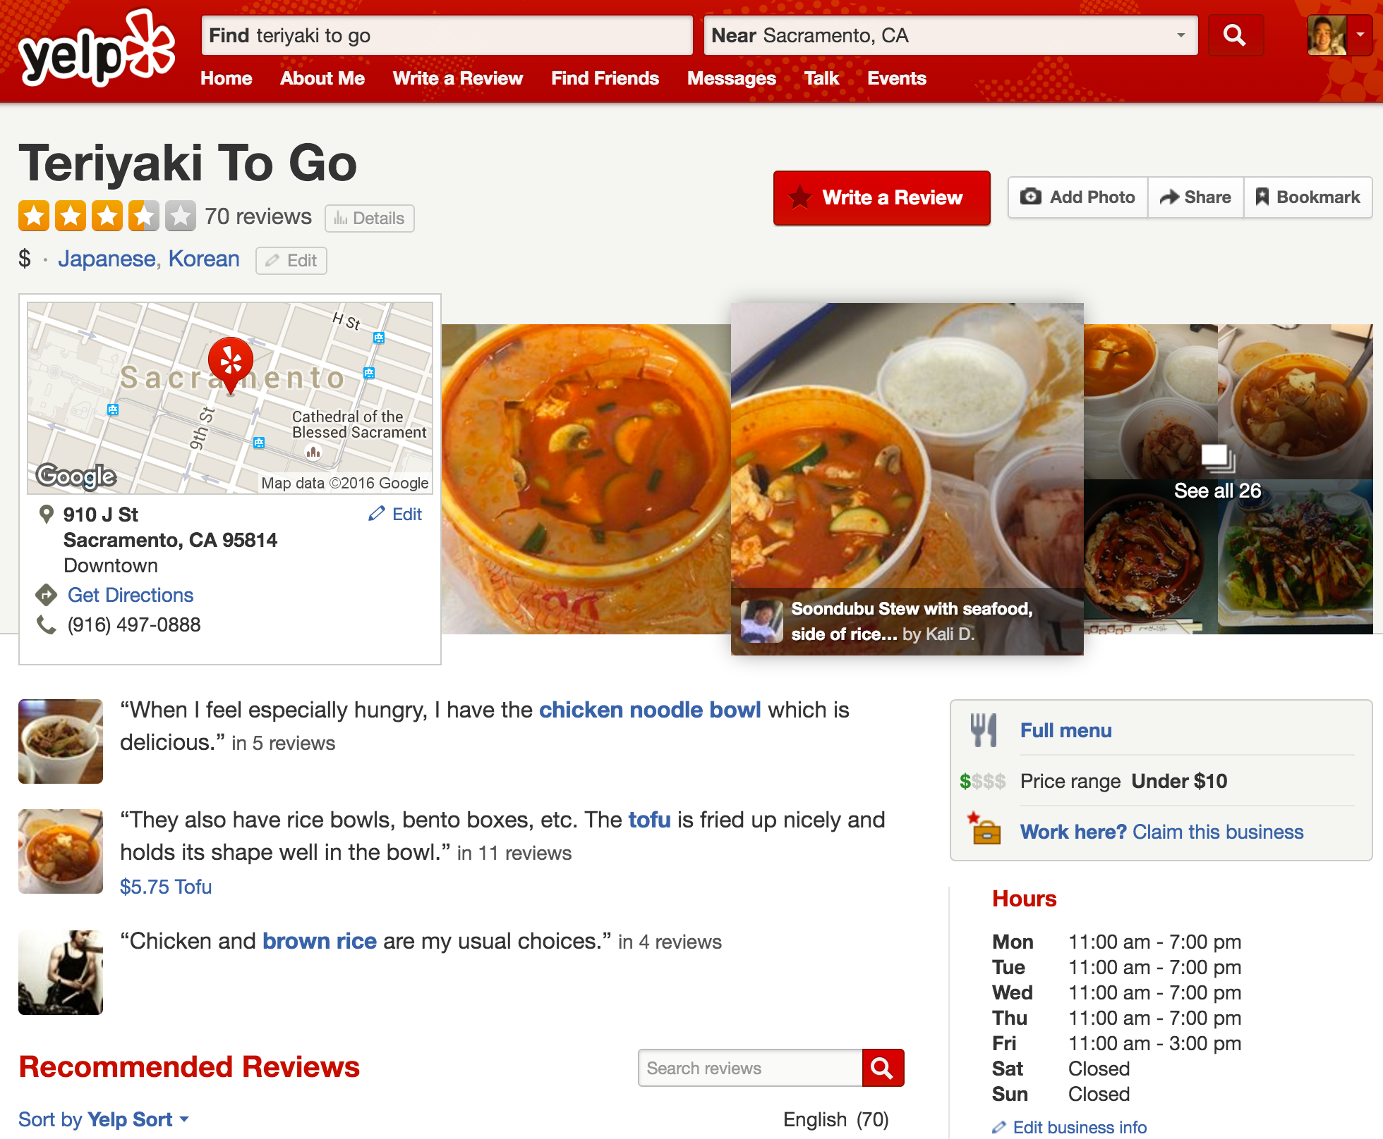

Slide 5
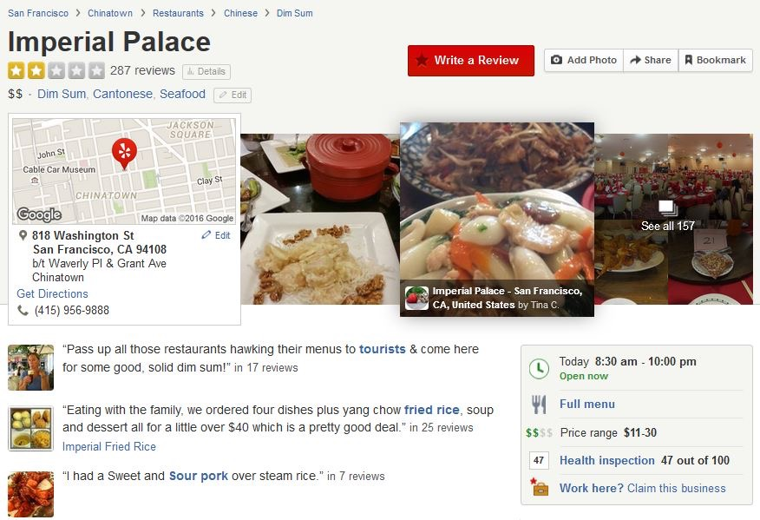

Slide 6
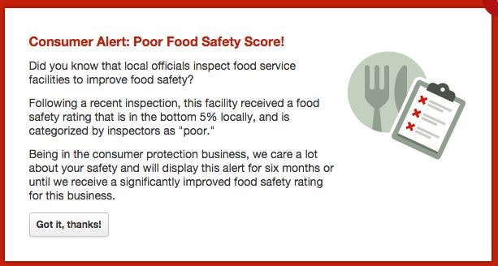

Slide 7
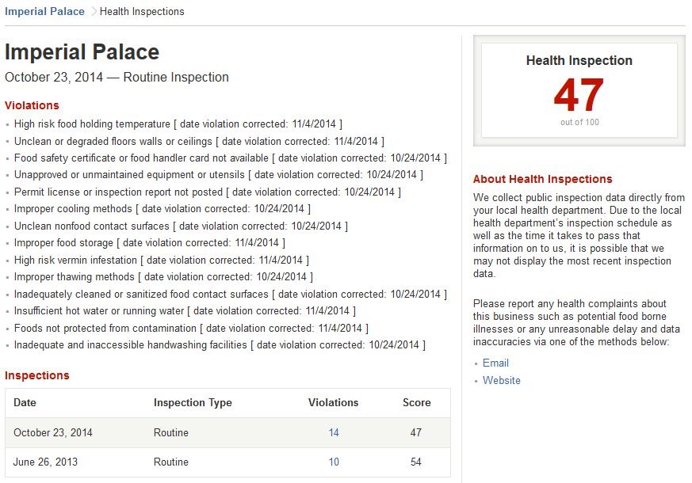

Slide 9
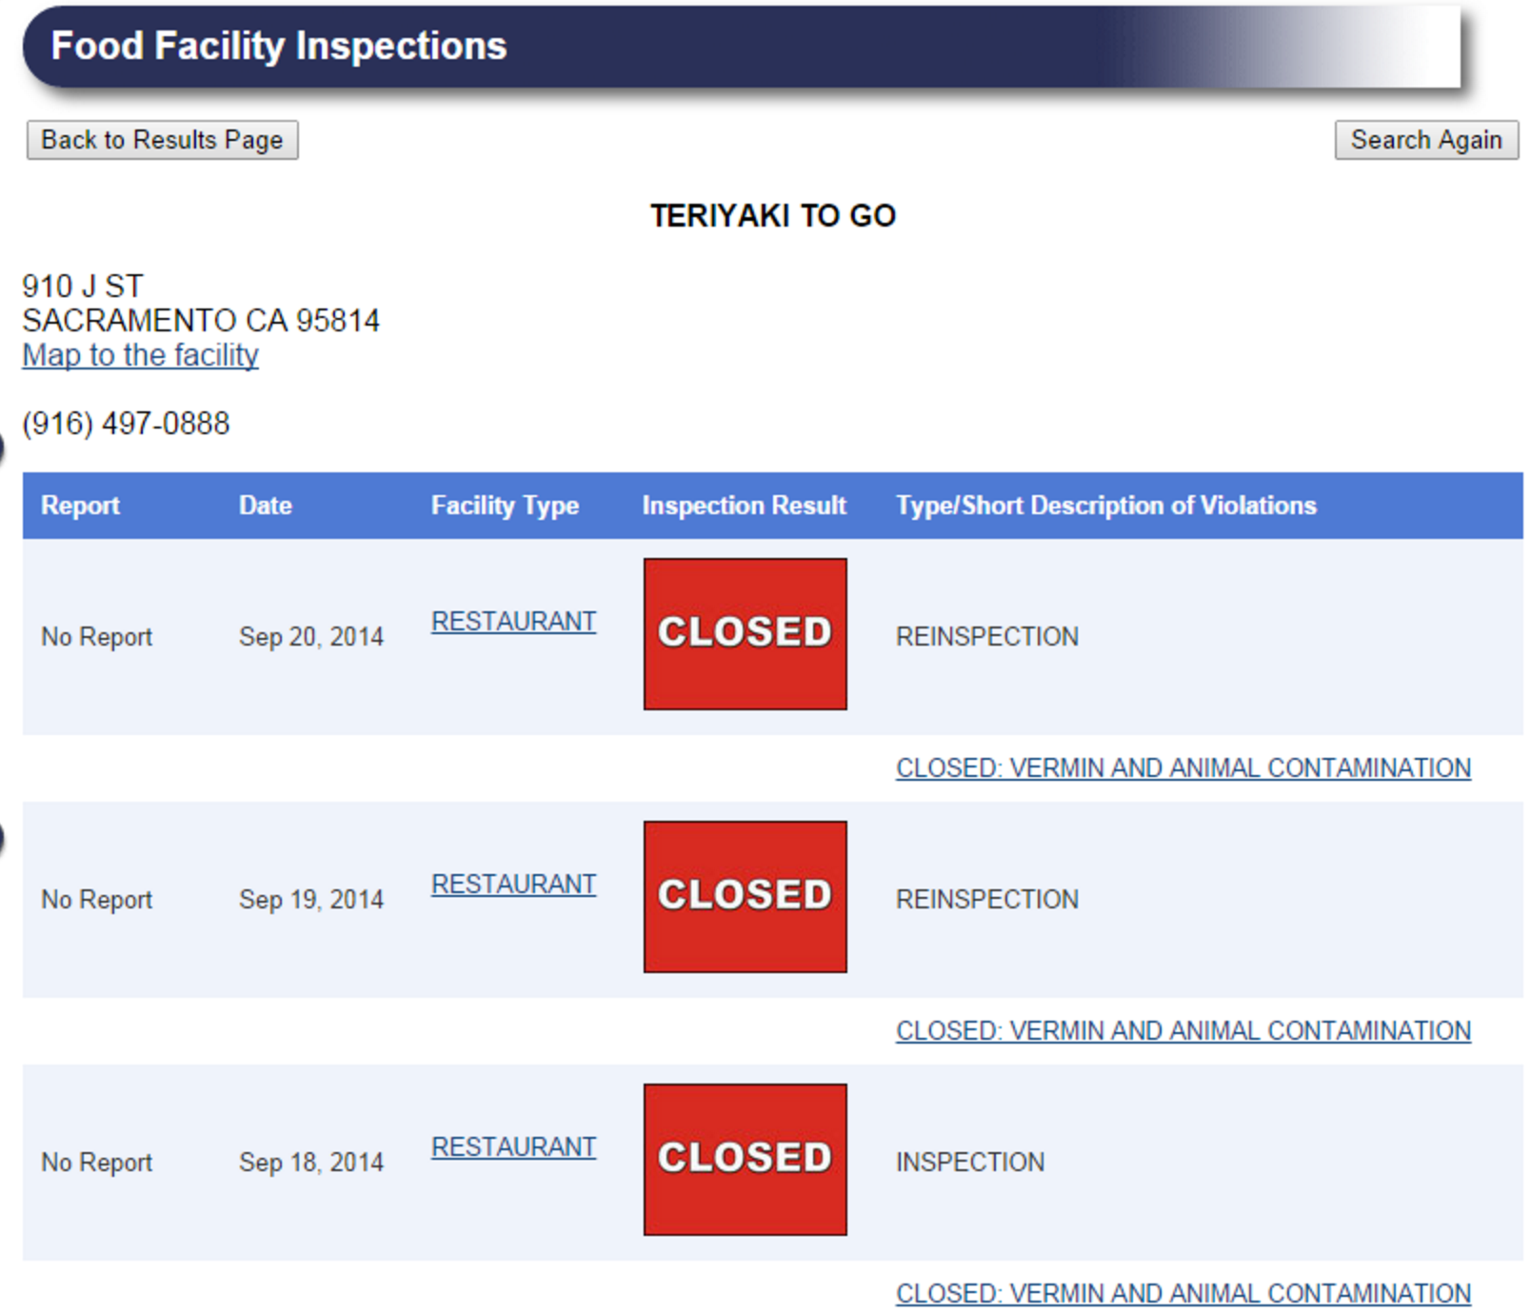

Slide 10
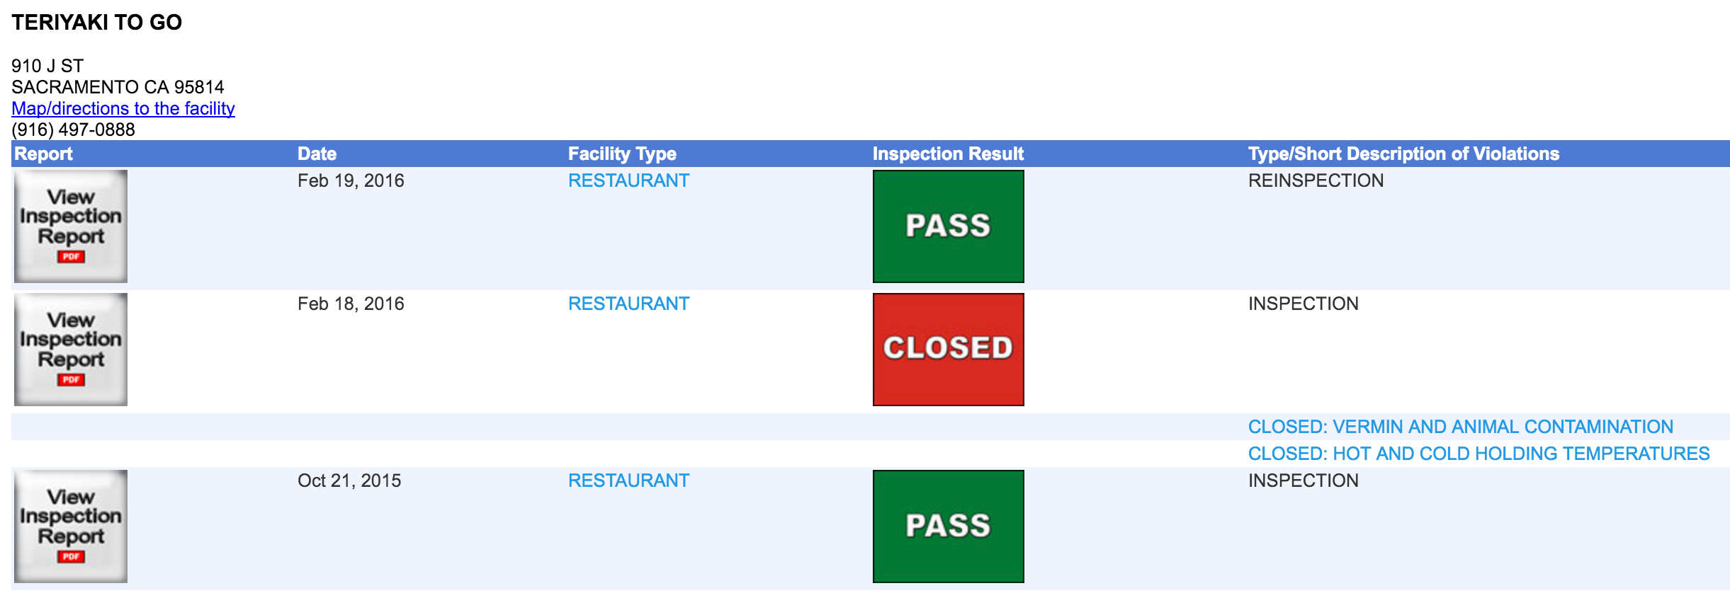
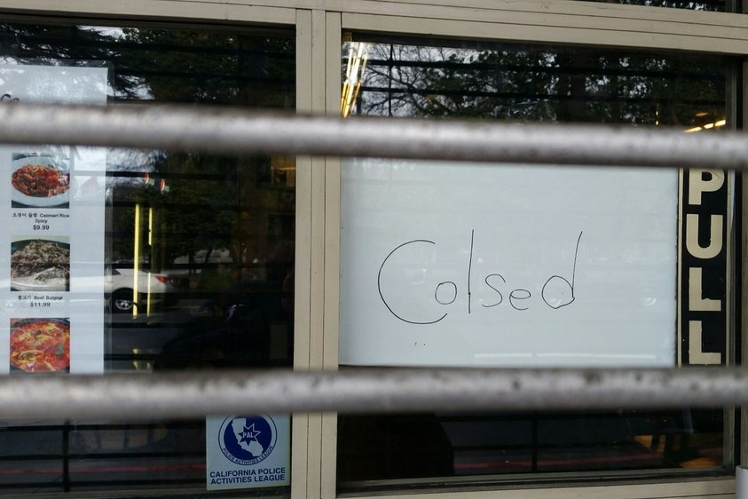
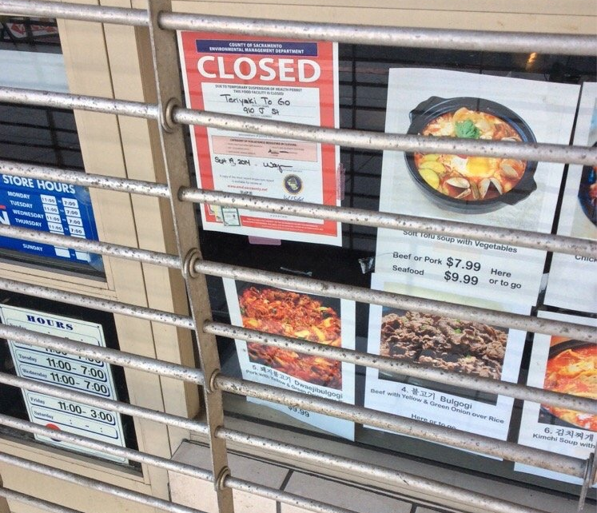

Slide 11
FAQs
When can it going live?
Will it be available for Yelp mobile as well?
How frequently will data be updated?
That’s nice, is it useful for anything else?

Slide 12
Policy Decisions
Open Data as of 2016-03-02
5,598 inspections
22,903 violations
500 for vermin (cockroaches, rats, etc.)
1 Red Fail
7 Yellow Conditional
5,590 Green Pass
.018% Fail
(Actually 99.76%)

Slide 13
FAQs
When is it going live?
Will it be available for Yelp mobile as well?
How frequently will data be updated?
That’s nice, is it useful for anything else?
How can this be developed further in the future?

Slide 14
Chicago Food Inspection Forecasting
Optimizing Inspections with Analytics
Previous major violations
High temperatures
Nearby garbage, sanitation and food illness complaints via 311
Type of facility
Concurrent tobacco or alcohol license
Time since last inspection
Time in business
Inspector assigned

Slide 15
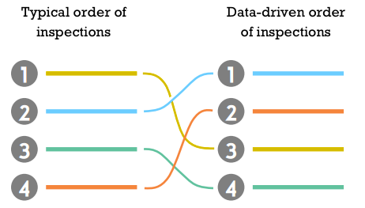
Chicago’s Result:
7 day earlier detection of
restaurants with critical violations
…
Healthier, safer people

Slide 16
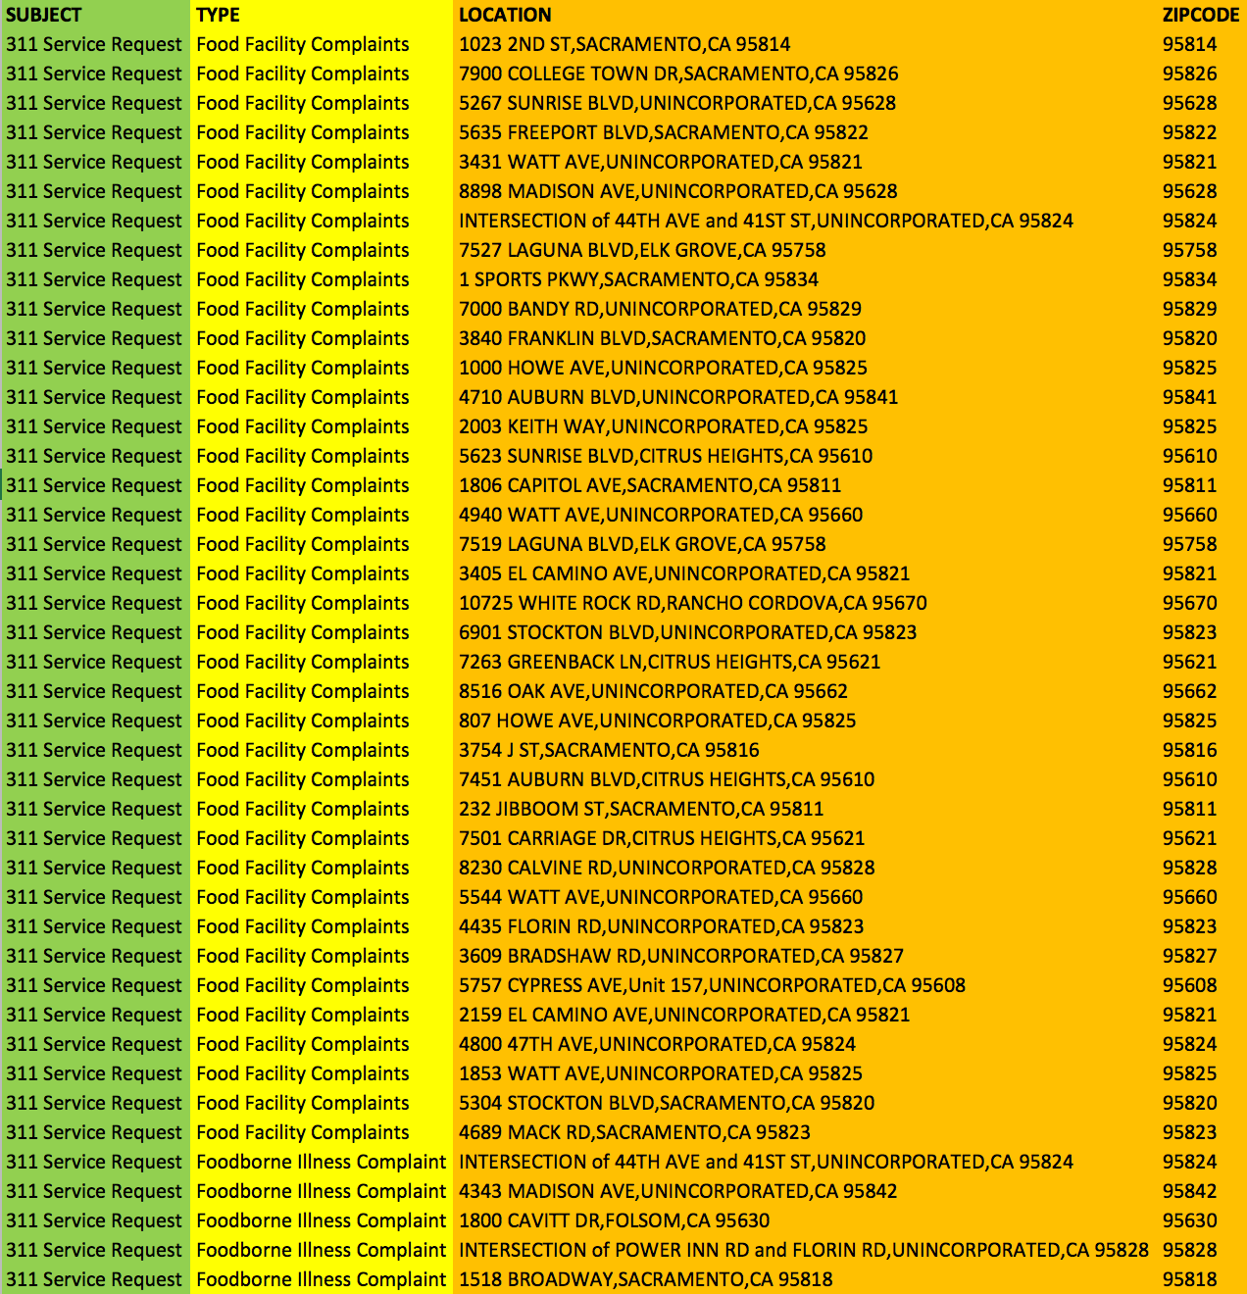
311 Open Data
Food Related Complaints for 2016

Slide 17

Chicago Food Inspection Forecasting
Optimizing Inspections with Analytics
Previous major violations
High temperatures
Nearby garbage, sanitation and food illness complaints via 311
Type of facility
Concurrent tobacco or alcohol license
Time since last inspection
Time in business
Inspector assigned

Slide 18
Use open data to allow common lay people to protect their health by making informed food safety decisions…
without the need for another app
TL;DR

Slide 19
Team ΔΣβ (DSB)
Joseph Lei Christine Feaster
joseph.lei@gmail.com feasterc@gmail.com
josephlei.com
github.com/josephlei github.com/femmestem
Special Thanks
Kelly McCoy Sacramento County EMD
Quy Le Yelp User Operations
Karina Salehi Yelp User Operations

